Slide 1

EEE 306 Project Presentation
Presented by: Group 3
Group members ID:
1906174, 1906175, 1906176, 1906177, 1906178

Slide 2
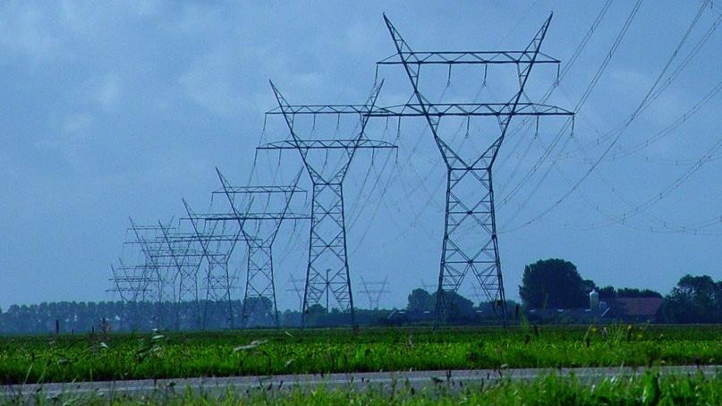
Comparison between High Voltage DC (HVDC) Transmission System and High Voltage AC (HVAC) System using SIMULINK

Slide 3
Objectives:
Build HVAC and HVDC transmission model in Simulink
Compare the two models with the help of different metrics

Slide 4
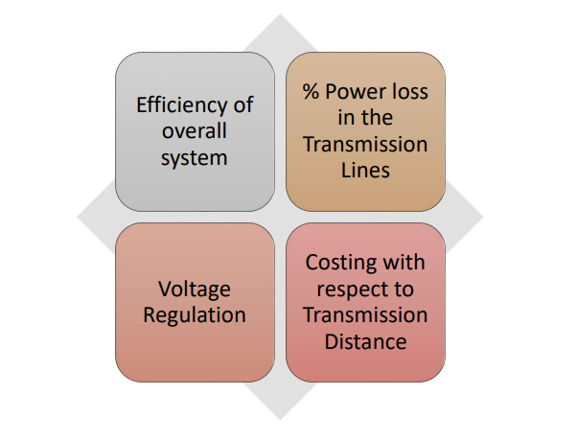
Comparison Metrics:

Slide 5
What is HVDC and HVAC Transmission System?
HVAC
A transmission system that transmits AC power at voltage about 33 kV to 230 kV is known as HVAC transmission system
HVDC
A transmission system that transmits DC power at a voltage about 100 kV to 800 kV is known as HVDC transmission system.

Slide 6
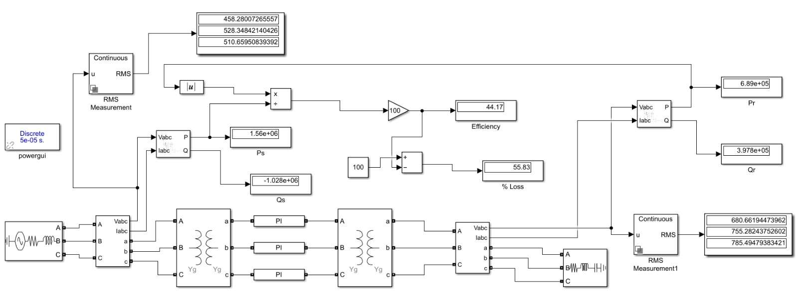
SIMULINK model of an HVAC system

Slide 7
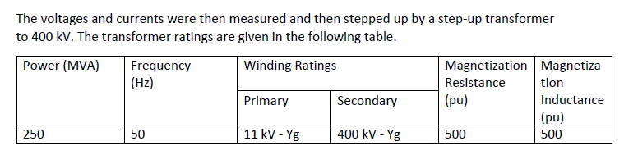

Components
Line Parameters

Slide 8
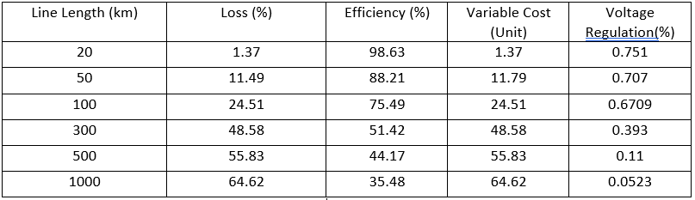
Simulation Result:
TABLE AC
Fig: AC Transmission Service

Slide 9
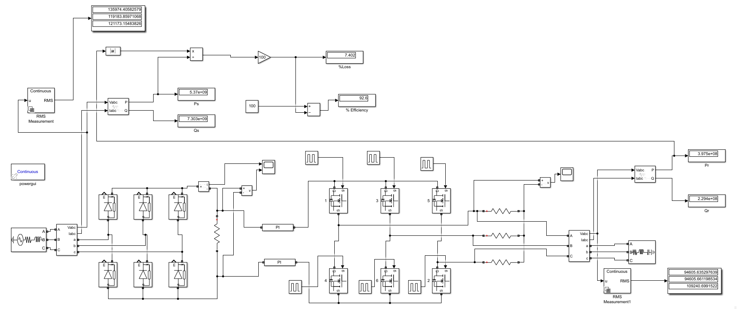
Simulink model of an HVDC system

Slide 10
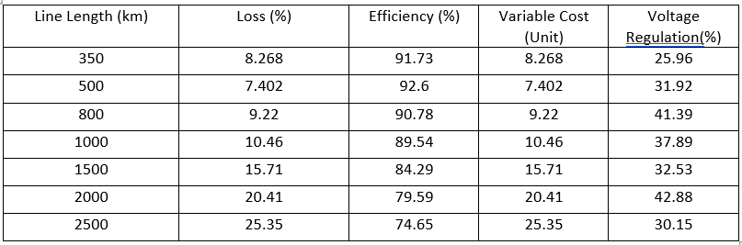
Simulation Result:
Table DC
Fig:DC Transmission System

Slide 11


Example Calculation Voltage regulation of HVAC system
Distance = 500 km
VNoLoad = 4218.85 V
VFullLoad = 4214 V
VR = $\frac{\text{4}\text{218.85−4214}}{\text{4214}}$ = 0.11%
At full load, (P=1 MW, QL=Qc= 50VAR)
At no load, (P=10 W, QL=Qc= 50VAR)

Slide 12

Voltage regulation of HVDC system
Distance =500 Km
VNo Load = 131243.33 V
VFull Load = 99483.99V
VR = $\frac{1312483.99−99483.99}{\text{99483.99}}$ = 31.92%
At full load, (P=1 MW, QL=Qc= 50VAR)
At no load, (P=10 W, QL=Qc= 50VAR)

Slide 13
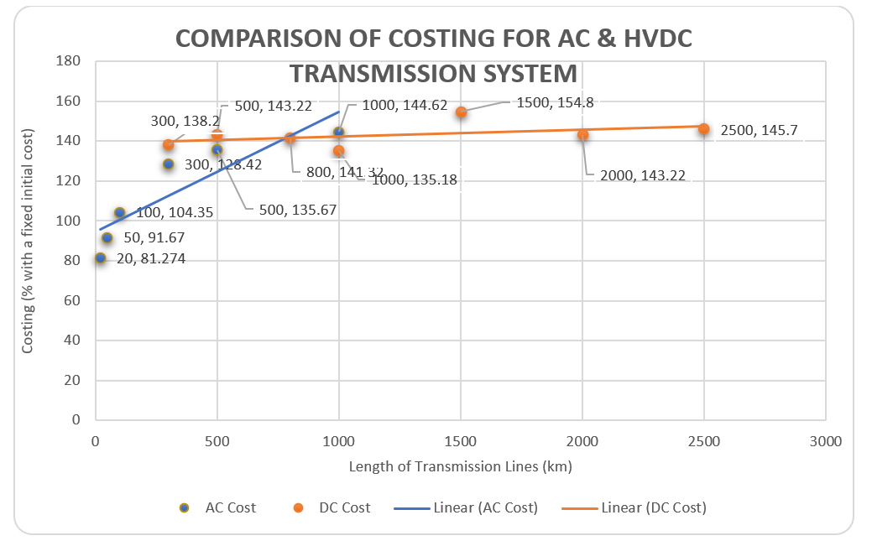
Transmission Cost Graph

Slide 14
Comparison Outcome
HVAC Transmission
Simple Voltage Transformation as AC Transformers are used
Low Fixed Cost
HVDC Transmission
Lower Transmission Loss
Low Variable cost
Less Expensive Components
Significantly Higher Efficiency for Long Transmission Distance
Lower Number of Conductors Needed for Transmission

Slide 15
THANK YOU

